Slide 1
Machine learning Model to Predict activity of short antimicrobial Peptides
KASHAF NAZ
SP18-BSI-025

Slide 2
Introduction

Slide 3
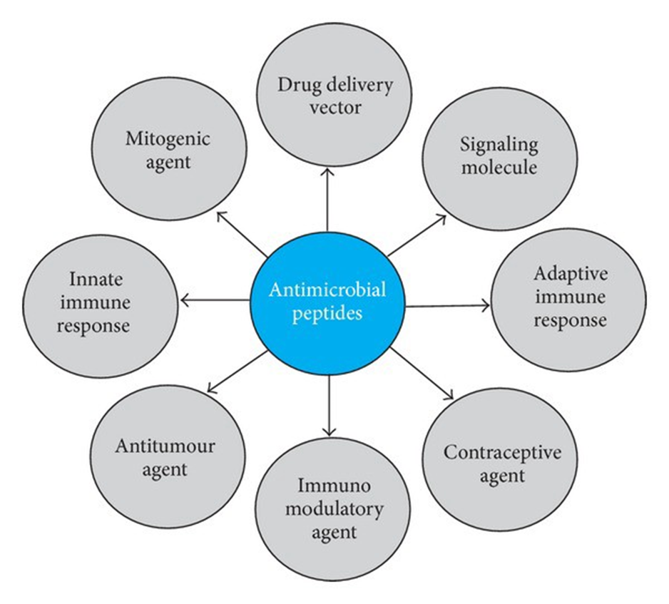
Antimicrobial peptides (AMPs; also called host defence peptides) are produced by most organisms as an innate immune response against microbes. They represent a large repertoire of antimicrobial agents and hence a valuable resource for drug discovery. In particular, cationic AMPs have received intense interest in recent years for their potential in the development of novel antibacterial drugs.

Slide 4
Problem Statement
Drugs are becoming ineffective against the treatment of antimicrobial infections. Antimicrobial peptides (AMPs; also called host defence peptides) are produced by most organisms as an innate immune response against microbes. They represent a large repertoire of antimicrobial agents and hence a valuable resource for drug discovery. Antimicrobial resistance is an urgent and global health problem as existing.

Slide 5
Methodology & Material

Slide 6
Data Set
Two datasets consisting of antimicrobial peptides (positive set) and non-antimicrobial peptides (negative set). Then, I will be computing some peptide features to quantitatively describe peptides followed by model building. finally, model interpretation where we shed light on the key important features important for predicting antimicrobial peptides.

Slide 7
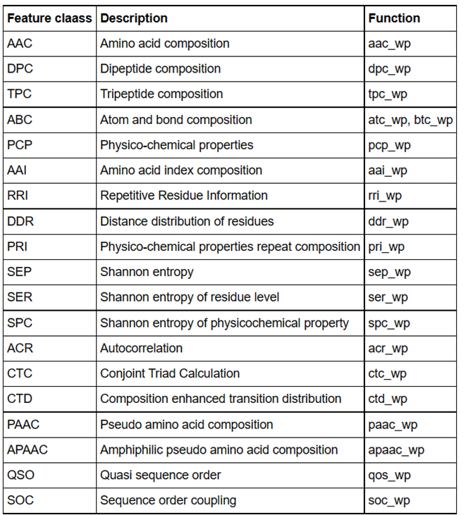
Here we compute two wp (whole peptide or protein) named AAC (Amino Acid Composition) from Pfeature and TPC (Tripeptide composition) from Pfeature we can aiport them as aac_wp and tpc_wp below table shows the composition-based features.

Slide 8
Google Colab
Conda
Pfeature zip
Unzipping
RF Model
Plot of Accuracy
Python
Plot of MCC
Model Performance
Feature
Importance
BioConda
lazypredict-Classifier
Train data set
Pos.fasta
Auto - ML
Train data set
Neg.fasta
Calculating
features
Composition
Feature
Remove Redundant

Slide 9
Calculating the AAC & TPC features
Peptide for positive dataset AAC, here we have 20 amino acid and 20 columns and 1337 number of rows and Each row represent different peptide and same as for tpc_wp.

Slide 10
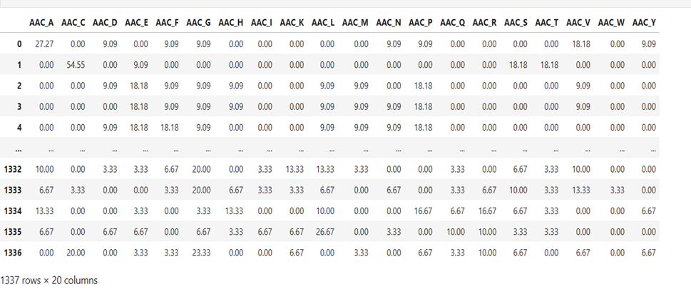
AAC

Slide 11
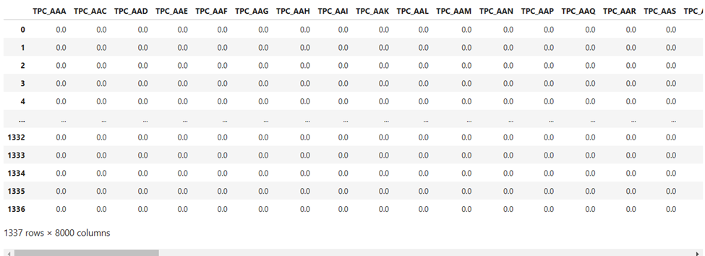
TPC

Slide 12
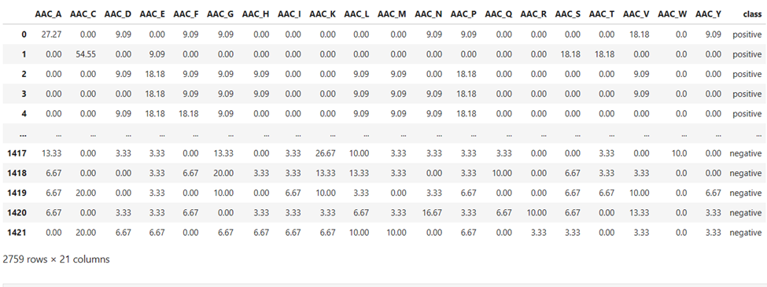
Both positive and negative classes + combines the two classes + merge with class labels - AAC

Slide 13
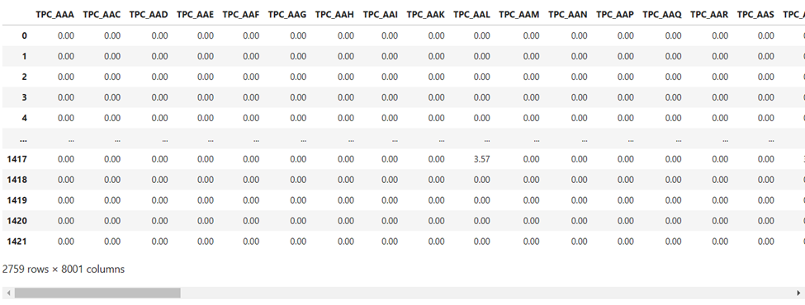
Both positive and negative classes + combines the two classes + merge with class labels - TPC

Slide 14
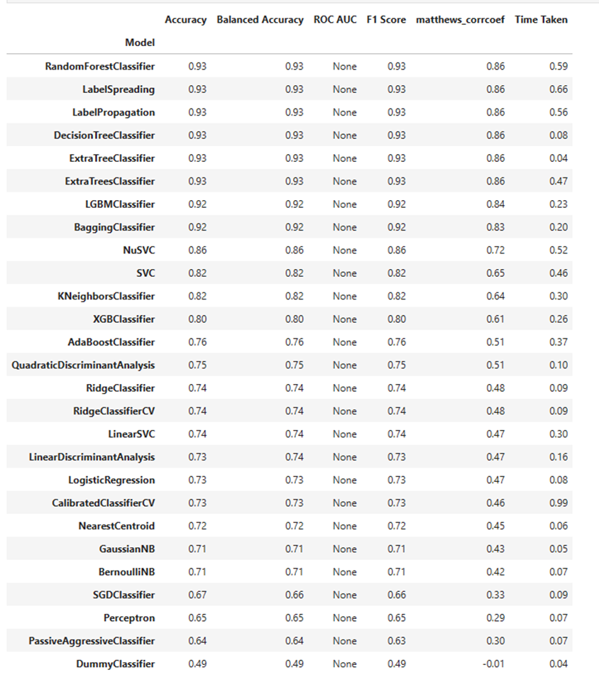
Prints the model performance (Training set)
AAC
Figure: Model performance (Lazy predict Classifier)

Slide 15
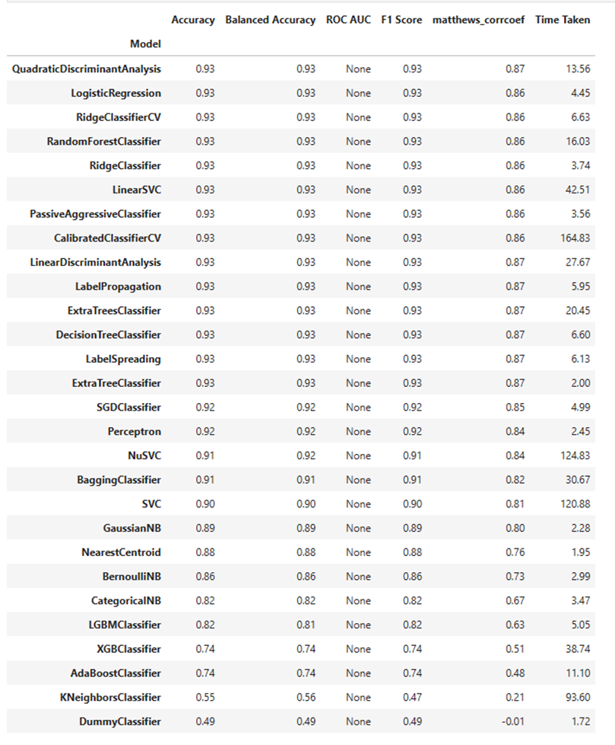
Prints the model performance (Training set)
TPC
Figure: Model performance (Lazy predict Classifier)

Slide 16
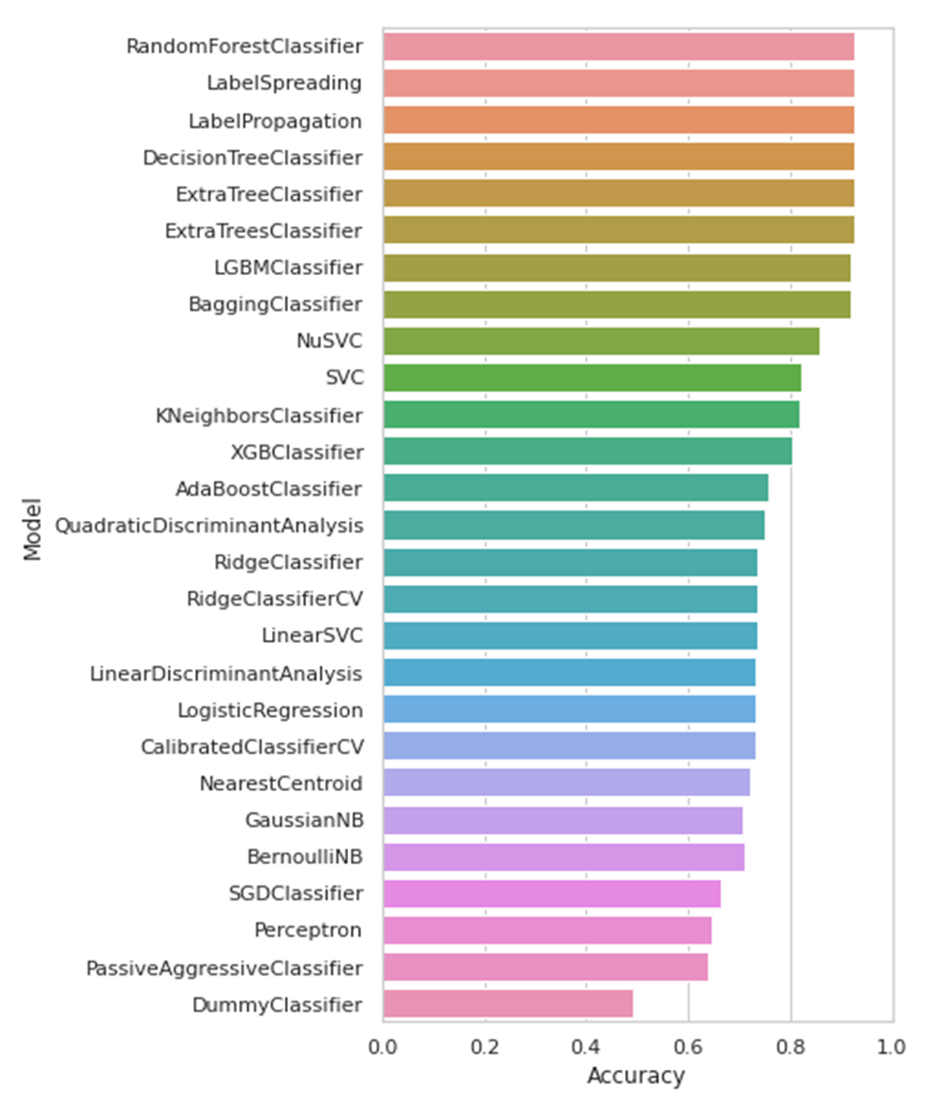
Plot of accuracy - AAC
Figure: Plot of Accuracy of amino acid composition

Slide 17
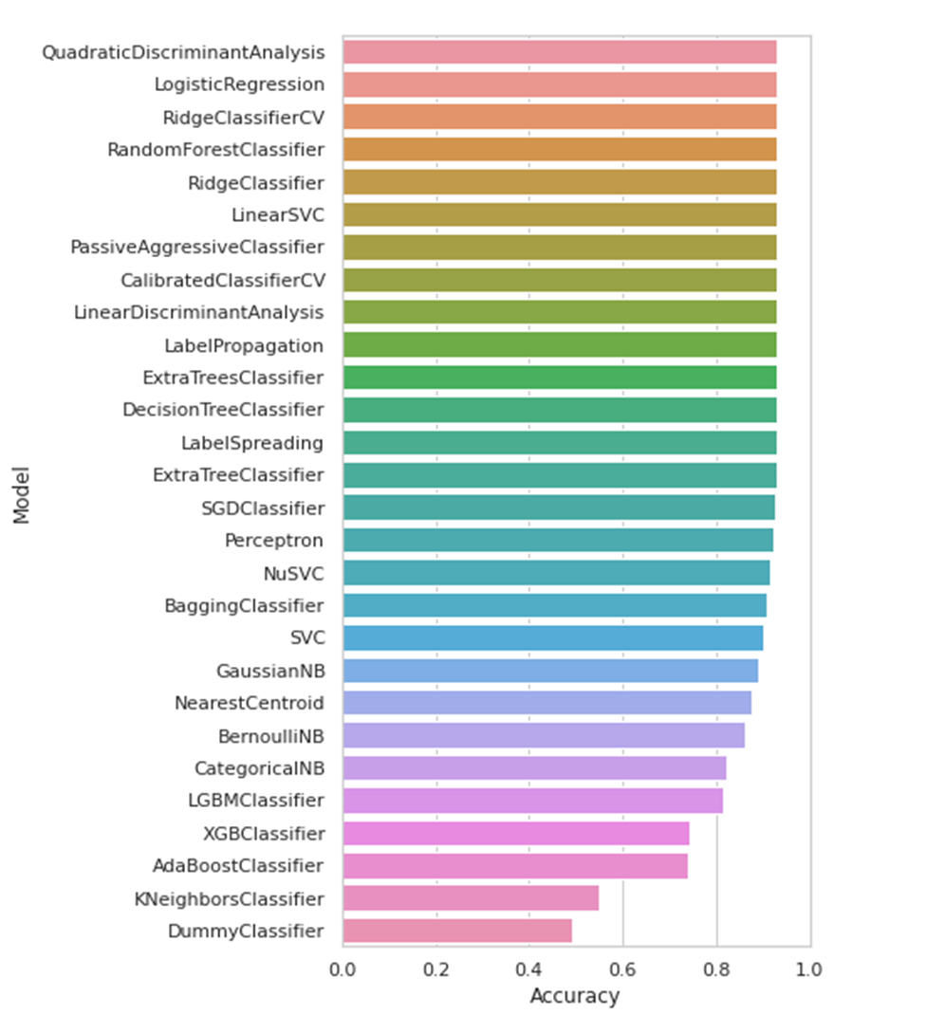
Plot of accuracy - TPC
Figure: Plot of Accuracy of Tripeptide composition

Slide 18
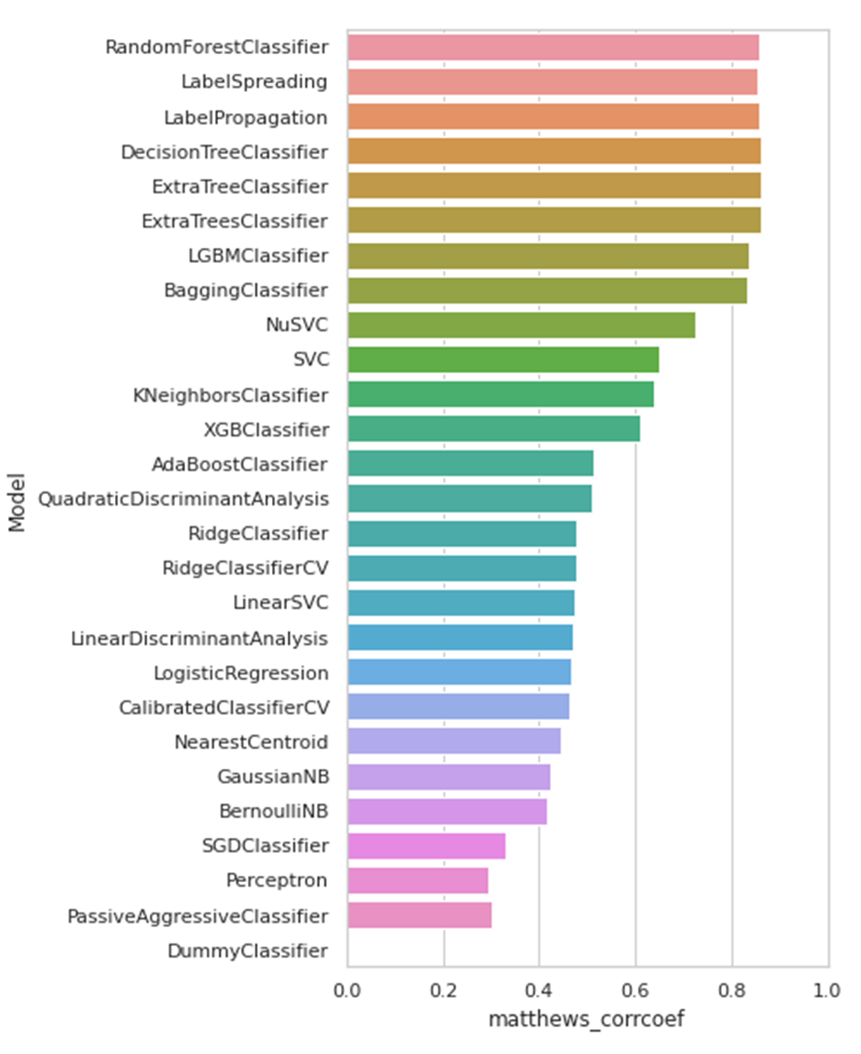
Plot of MCC - AAC
Figure: Plot of Matthews correlation coefficient
amino acid composition

Slide 19
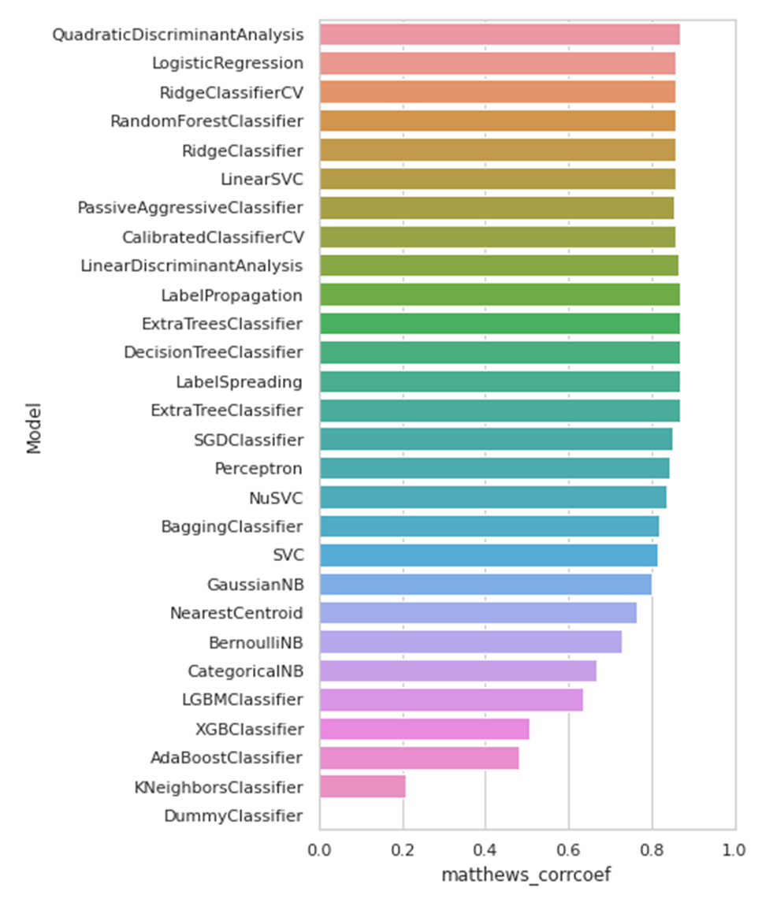
Plot of MCC - TPC
Figure: Plot of Matthews correlation coefficient
amino acid composition

Slide 20
Results

Slide 21
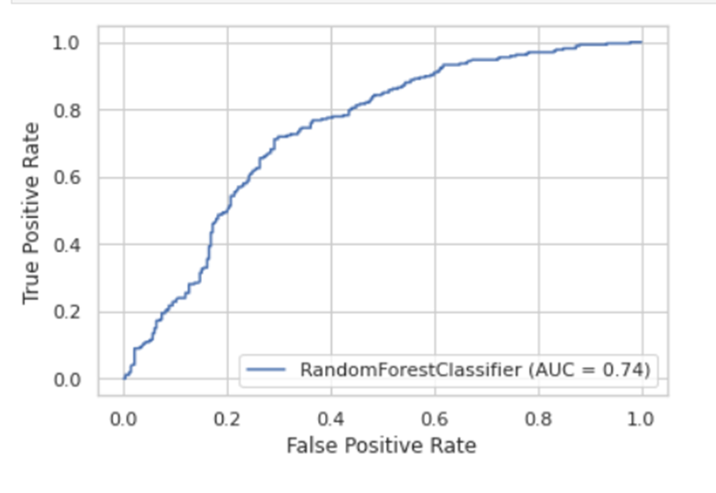
ROC Curve for test dataset - AAC
Figure: Plot of Receiver Operator Characteristic amino acid composition

Slide 22
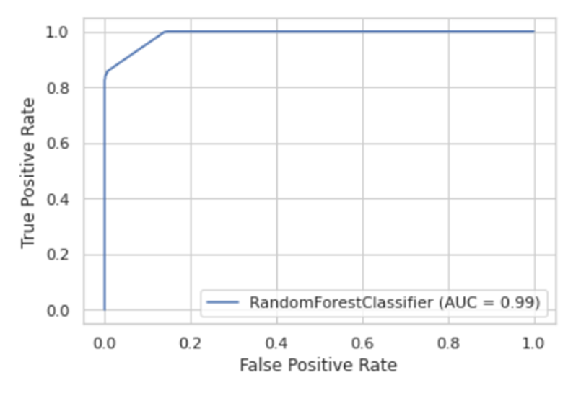
ROC Curve for train dataset - AAC
Figure: Plot of Receiver Operator Characteristic of amino acid composition

Slide 23
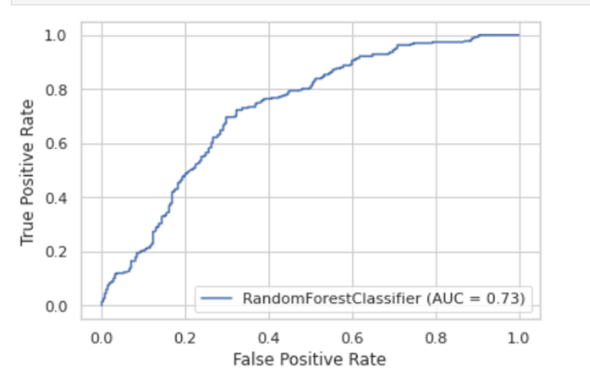
ROC Curve for test dataset - TPC
Figure: Plot of Accuracy of amino acid composition

Slide 24
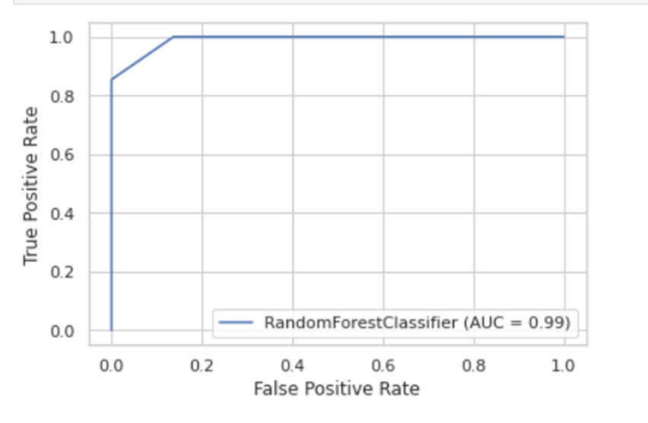
ROC Curve for train dataset - TPC
Figure: Plot of Accuracy of amino acid composition

Slide 25
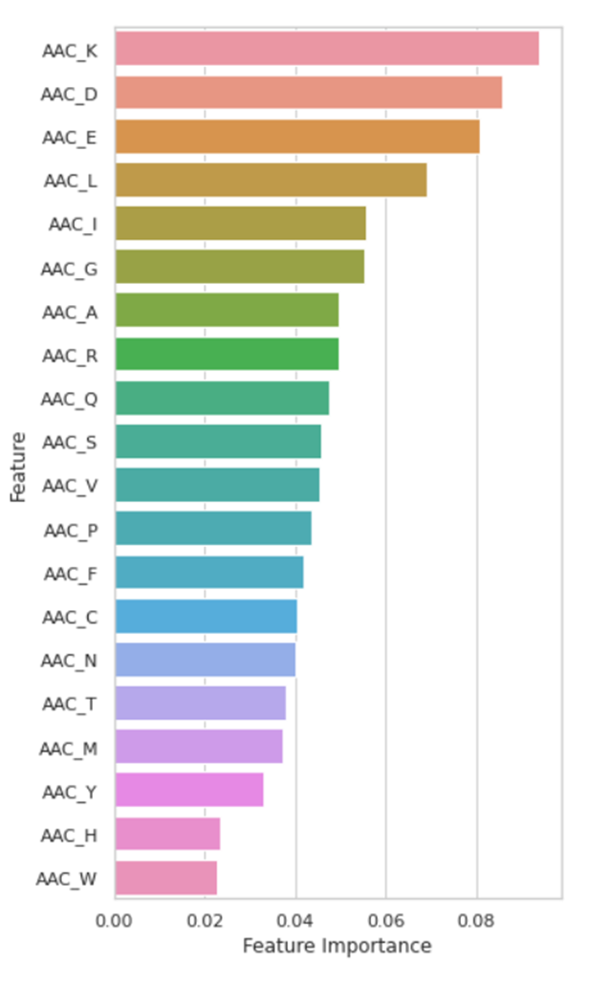
Plot of feature importance - AAC
Figure: Plot of feature importance of amino acid composition

Slide 26
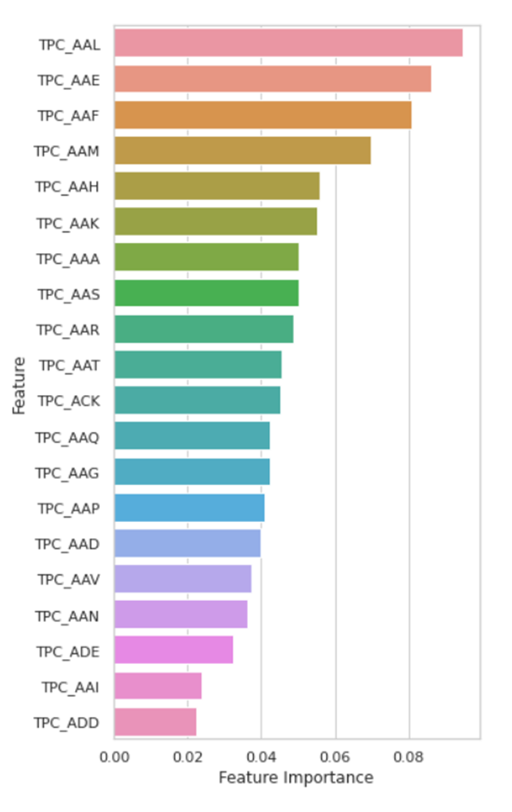
Plot of feature importance - TPC
Figure: Plot of Accuracy of tripeptide composition

Slide 27
Discussion

Slide 28
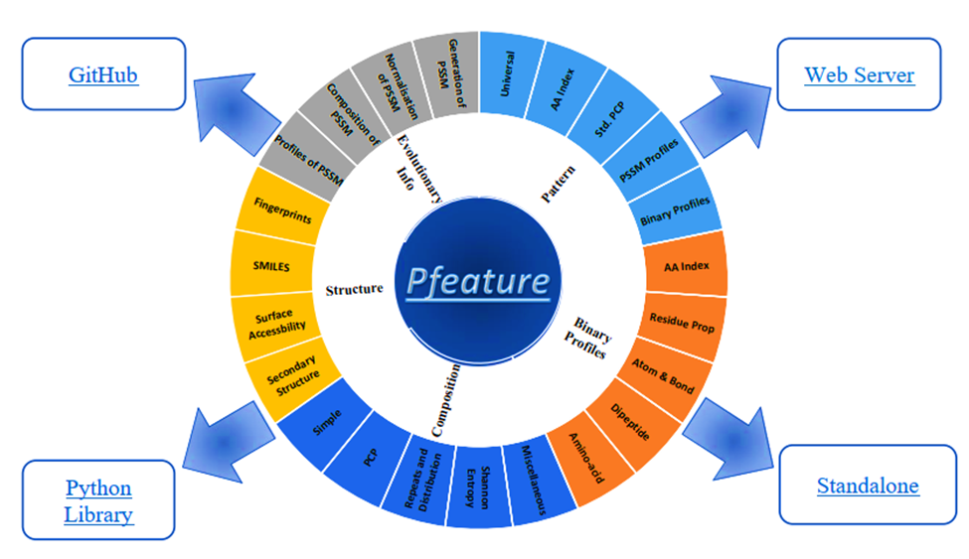
Future Aspects

Slide 29
Conclusion

Slide 30
Antimicrobial peptides are known to exhibit a broad spectrum of activity, including antibacterial, anticancer, antifungal, and antiviral, among others. Increasing reports of bacterial resistance to conventional antibiotics urgently demand effective methods to discover new AMPs. Short AMPs are better drug options because of their low production cost, higher stability, and minimal damage to host cells.

Slide 31
Thank You

